Slide 1
SQL PROJECT

Slide 2


LIBRARY MANAGEMENT SYSTEM

Slide 3
INTRODUCTION
This project is a Library Management System that allows for efficient management of a library's operations. It provides functionalities to track books, customers, employees, book issuance, and returns. The system, done using SQL, maintains a comprehensive database of books, their availability status, rental cost, and other relevant details. It also enables effective management of customers and employees associated with the library.

Slide 4
DATABASE OVERVIEW
The Library Management SQL Project stimulates a database designed for a library tracking platform.The project demonstrates how SQL can be used to manage and query data related to library, books, authors, customers, employees and many more…
Book Management: Add, update, and remove books from the library's collection. Track book details such as title, category, rental price, availability status, author, and publisher.
Customer Management: Maintain a record of library customers, including their names, addresses, registration dates, and issuance history.
Employee Management: Manage library staff, including employee names, positions, salaries, and branch assignments.
Book Issuance and Returns: Track the issuance and return of books by customers. Monitor the status of issued books and ensure timely returns.
Branch Management: Maintain information about library branches, including branch numbers, manager assignments, addresses, and contact details.

Slide 5
RELATIONSHIPS
1.Books and Authors
Relationship : One-to-Many
One author can write multiple books. Each book has one author
2. Books and Publishers
Relationship : One-to-Many
One publisher can publish multiple books. Each book has one publisher
3. Branches and Books
Relationship : One-to-Many
One branch can have multiple books. Each book belongs to one branch
4. Branches and Employees
Relationship : One-to-Many
One branch can have multiple employees. Each employee works at one branch
5. Branch Manager
Relationship : One-to-One
One employee can manage one branch. Each branch has one manager
6. Books and Customers
Relationship : Many-to-Many
One customer can borrow multiple books.One book can be borrowed by multiple customers (over time).

Slide 6
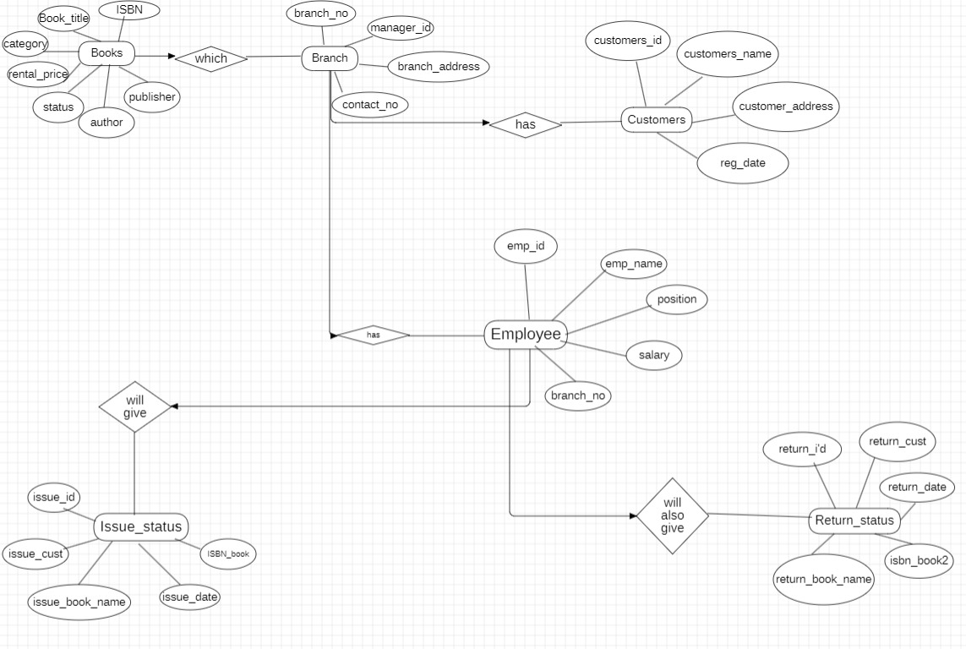
ER DIAGRAM

Slide 7
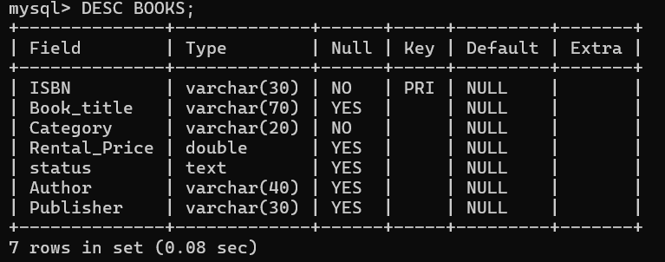
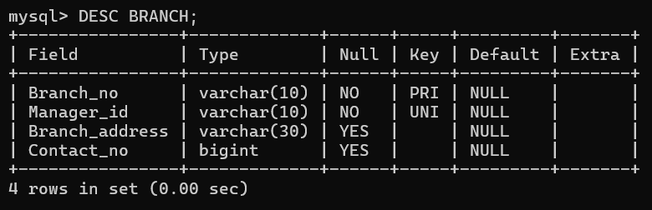
STRUCTURE OF TABLES
BOOK MANAGEMENT TABLE
BRANCH TABLE

Slide 8
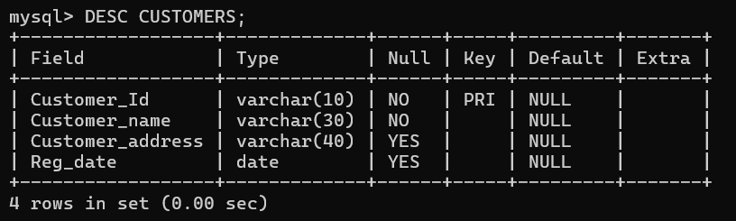
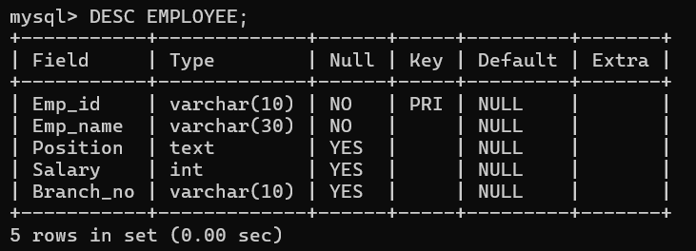
CUSTOMERS TABLE
EMPLOYEE TABLE

Slide 9
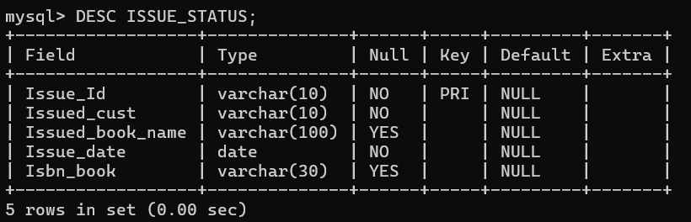
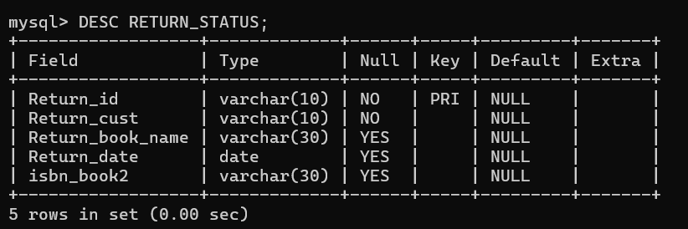
ISSUE_STATUS TABLE
RETURN_STATUS TABLE

Slide 10
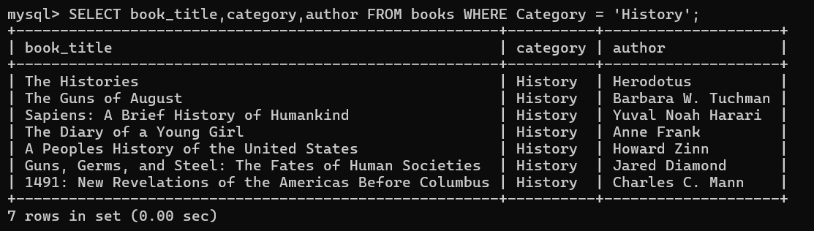
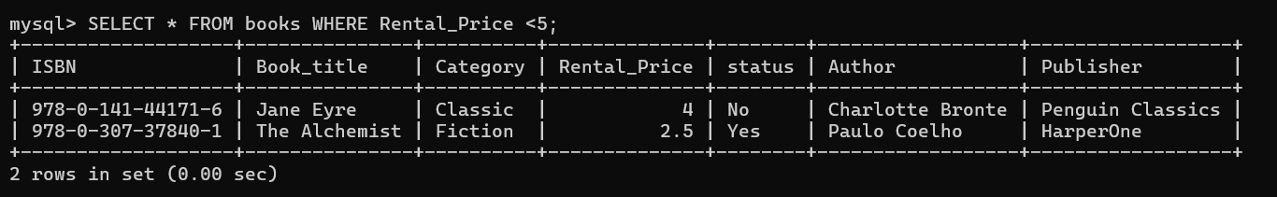
QUERIES
Q1. Select book_title,Category,Author by a specific Category = ‘History’.
Ans. SELECT * FROM books WHERE ;
Q2. Retrieve books with rental price less than 5 .
Ans. SELECT * FROM books WHERE Rental_Price <5;

Slide 11
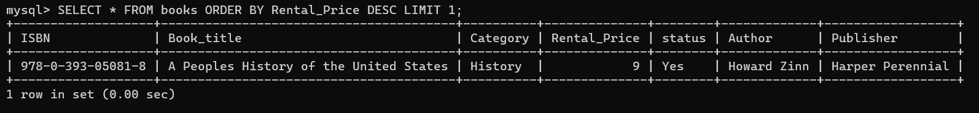
Q3. Retrieve the most expensive book from books table .
Ans. SELECT * FROM books ORDER BY Rental_Price DESC LIMIT 1;
Q4 . Insert a new book record into books table .
Ans. INSERT INTO book(ISBN, Book_title, Category, Rental_Price, Status, Author, Publisher)
VALUES ('978-1- 23-456789-0', 'New Book', 'Science Fiction', 6.5, 'Yes', 'Author Name', 'Publisher Name');

Slide 12
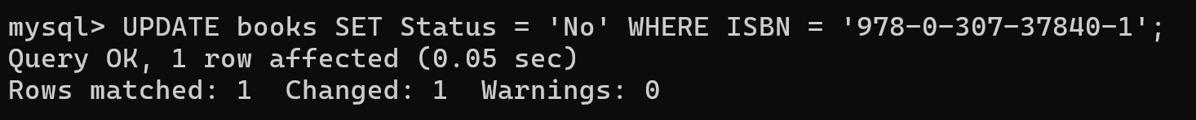
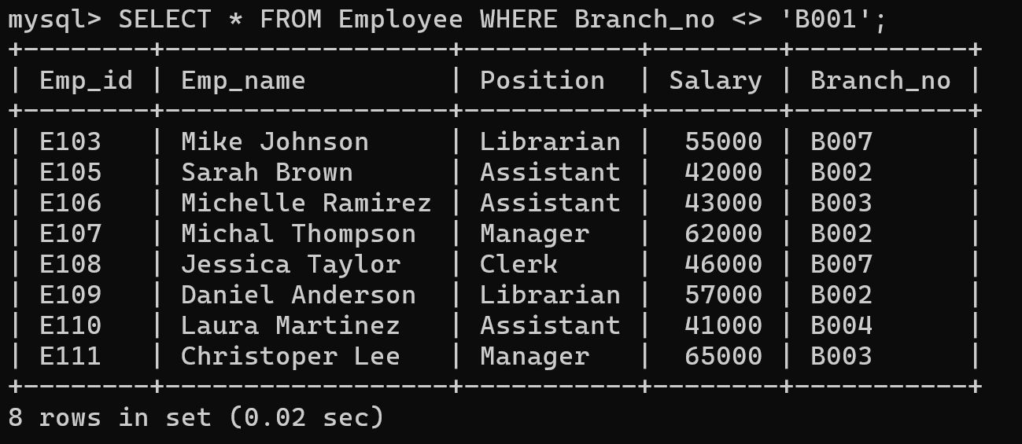
Q5. Update the status of a specific book .
Ans. UPDATE books SET Status = 'No' WHERE ISBN = '978-0-307-37840-1';
Q6. Find employees NOT working in Branch B001.
Ans. SELECT * FROM Employee WHERE Branch_no <> 'B001';

Slide 13
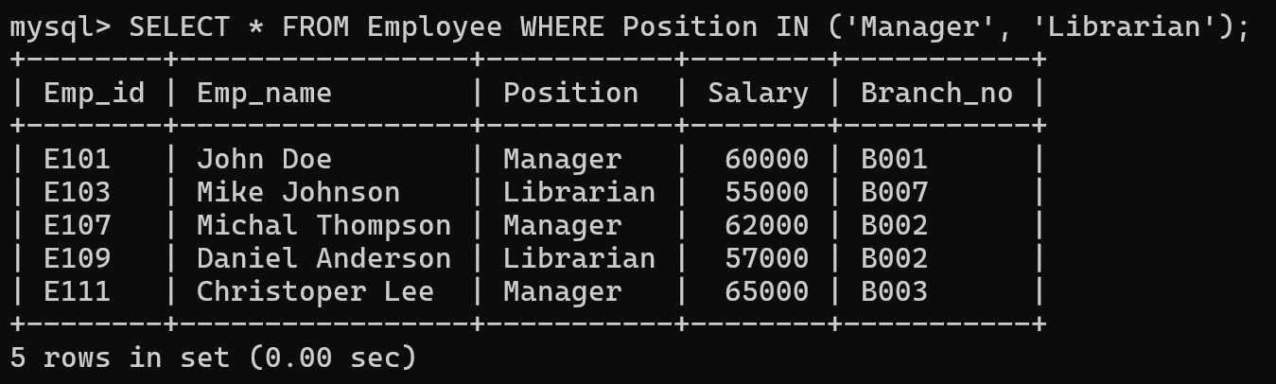
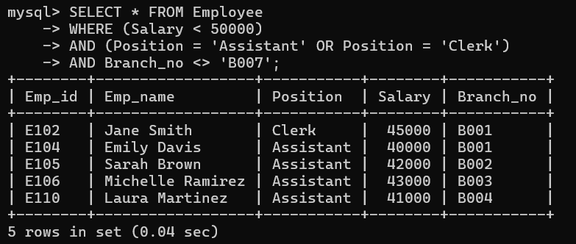
Q7. Find employees with specific positions .
Ans. SELECT * FROM Employee WHERE Position IN ('Manager', 'Librarian');
Q8. Complex query with multiple conditions .
Ans. SELECT * FROM Employee WHERE (Salary < 50000) AND (Position = 'Assistant' OR Position = 'Clerk’)
AND Branch_no <> 'B007';

Slide 14
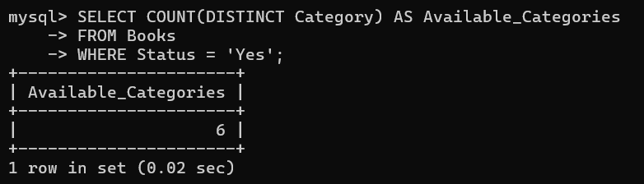
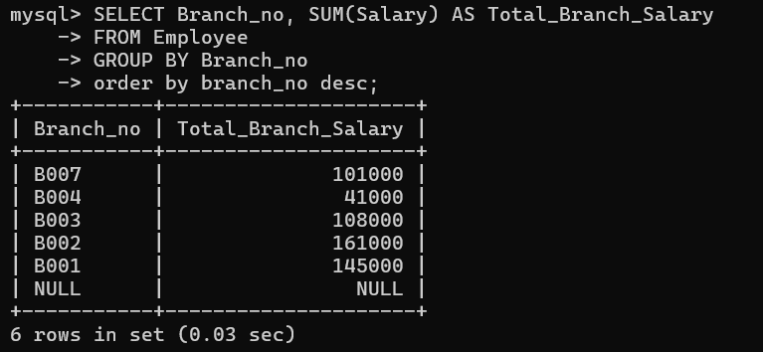
Q9. Count unique categories available for rental .
Ans. SELECT COUNT(DISTINCT Category) AS Available_Categories FROM Books WHERE Status = 'Yes';
Q10. Which branch has the highest total salary expenditure .
Ans. SELECT Branch_no, SUM(Salary) AS Total_Branch_Salary FROM Employee GROUP BY Branch_no
ORDER BY Branch_no desc;

Slide 15
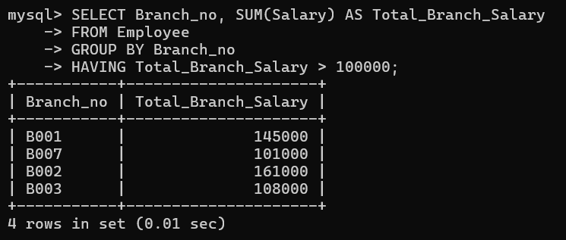
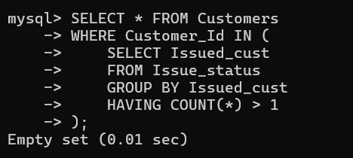
Q11. Which branches have a total salary expenditure exceeding $100,000 .
Ans. SELECT Branch_no, SUM(Salary) AS Total_Branch_Salary FROM Employee GROUP BY Branch_no
HAVING Total_Branch_Salary > 100000;
Q12. Which customers have borrowed more than one book from our library .
Ans. SELECT * FROM Customers WHERE Customer_Id IN (SELECT Issued_cust FROM Issue_status
GROUP BY Issued_cust HAVING COUNT(*) > 1);

Slide 16
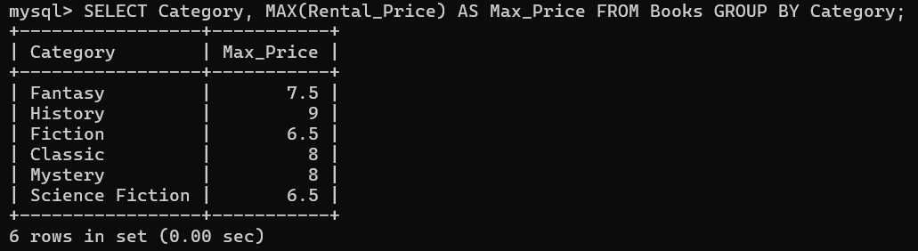
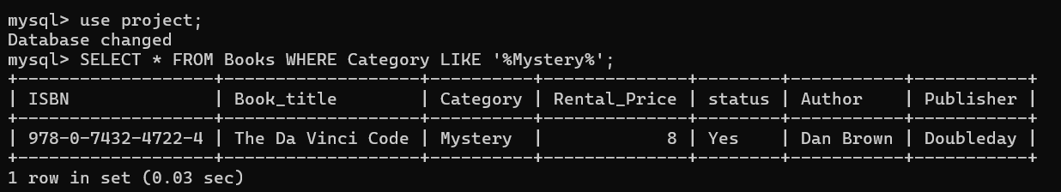
Q13.Find the most expensive book in each category
Ans. SELECT Category, MAX(Rental_Price) AS Max_PriceFROM Books GROUP BY Category;
Q14. Find books where the Category contains the word ‘Mystery’
Ans. SELECT * FROM Books WHERE Category LIKE ‘%Mystery%';

Slide 17
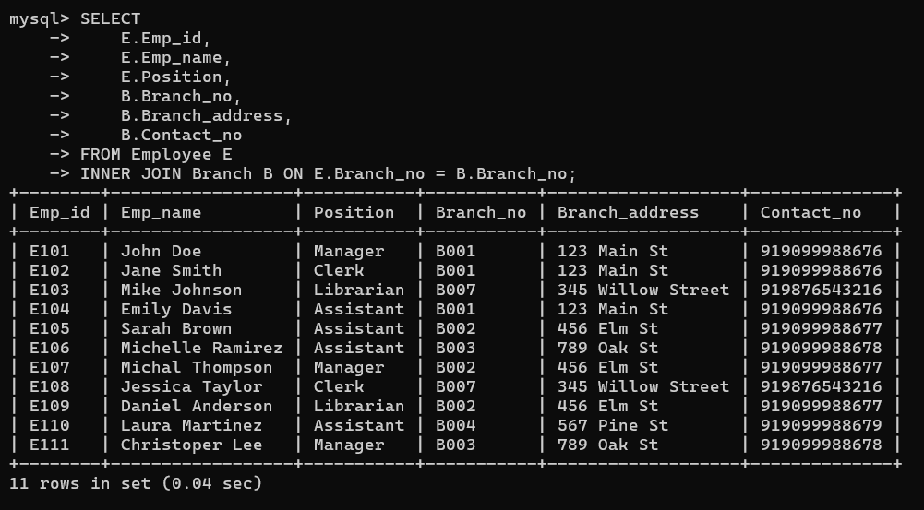
Q15. INNER JOIN between Employees and Branches showing employee details with their branch information .
Ans. SELECT E.Emp_id, E.Emp_name, E.Position, B.Branch_no, B.Branch_address, B.Contact_no
FROM Employee E INNER JOIN Branch B ON E.Branch_no = B.Branch_no;

Slide 18
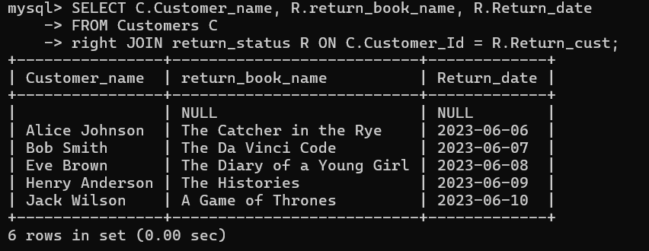
Q16. How many customers did returned the book .
Ans. SELECT
C.Customer_name, R.return_book_name,R.Return_date
FROM Customers C
RIGHT JOIN
return_status R ON C.Customer_Id = R.Return_cust;

Slide 19
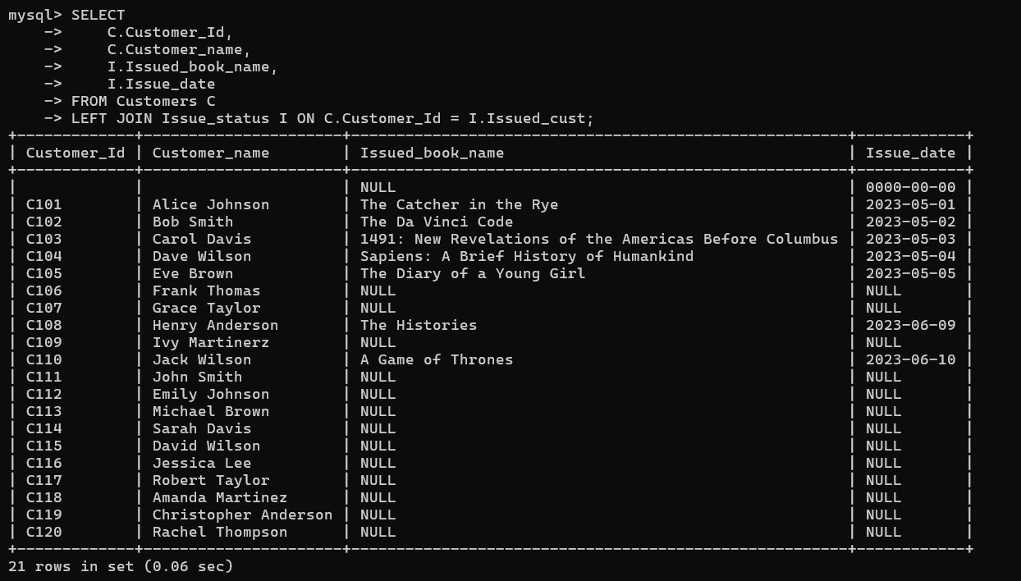
Q17. LEFT JOIN between Customers and Issue Status showing all customers and their book issue history .
Ans. SELECT C.Customer_Id, C.Customer_name, I.Issued_book_name, I.Issue_date FROM Customers C
LEFT JOIN Issue_status I ON C.Customer_Id = I.Issued_cust;

Slide 20
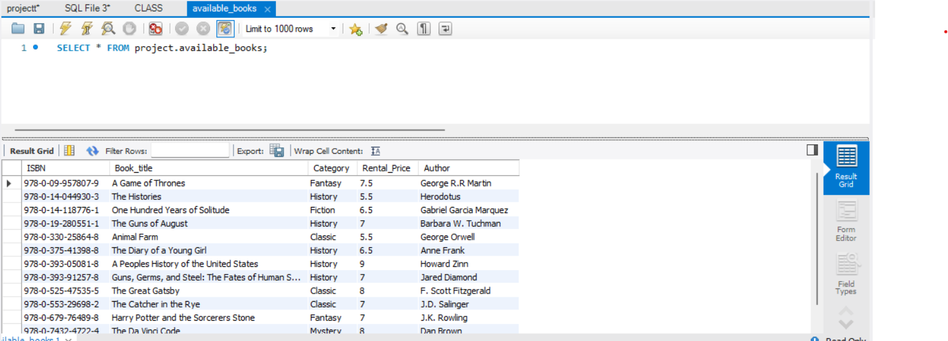
Q18. Create a view of available books .
Ans. CREATE VIEW Available_Books AS SELECT ISBN, Book_title, Category,
Rental_Price, Author FROM Books WHERE Status = 'Yes';

Slide 21




